Slide 1
Finding Nearest Neighborhood in Vancouver
Anow Fanny Durairaj
Coursera - Capstone Project

Slide 2
Business Problem
The business problem aims to target the stakeholders who wants to starts a business in Vancouver City in Canada. This problem will analysis the crime data for opening a store and shortlists the neighborhood where the kind of store is not as close to the city.
Task includes:
Analyze the crime data by choosing the safest Borough
Find the list of neighborhood
Choose the close neighborhood to the city
We have used the Data Science tools to analyze and focus on the data and explore the neighborhoods and the 10 most common venues in each neighborhood. This helps to find the best neighborhood that can be selected where the store is not the common venue.

Slide 3
Data Description
Based on definition of the problem, the following factors will influence our decision:
Find the safest borough based on crime statistics
Find the most common venues
Choose the right neighborhood within the Borough
The following data sources are extracted/generated:
A dataset consisting of the crime statistics of each Neighborhood in Vancouver along with type of crime, recorded year, month and hour.
Borough information is used to map the existing data where each neighborhood can be assigned with the right borough.
Data fetched using OpenCage Geocoder to find the safest borough, explore the neighborhood by plotting it on maps using Folium, and perform exploratory data analysis.
Data fetched using Four Square API to explore the neighborhood venues and to apply machine-learning algorithm to cluster the neighborhoods and present the findings by plotting it on maps using Folium.

Slide 4
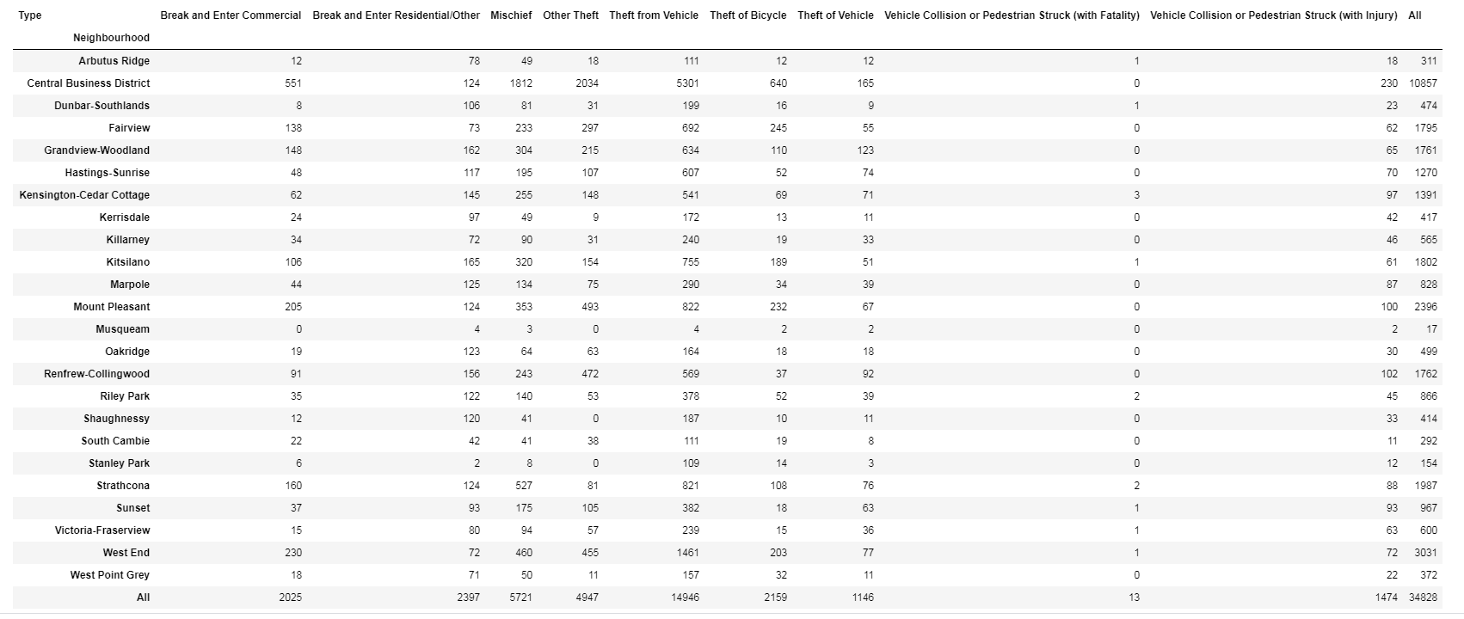
Vancouver Crime Report Data
Reading from the Dataset
Data set URL: https://www.kaggle.com/agilesifaka/vancouver-crime-report/version/2
[Wikipedia page](https://en.wikipedia.org/wiki/List_of_neighbourhoods_in_Vancouver)

Slide 5
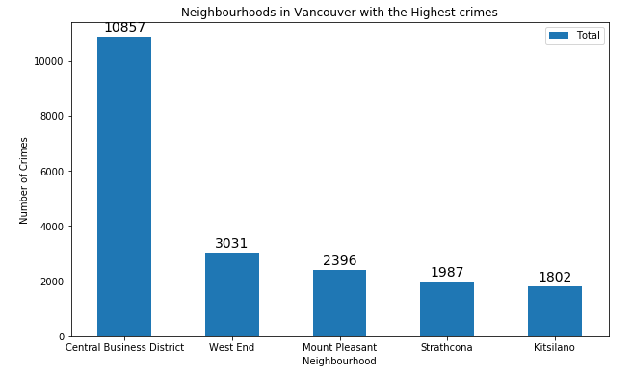
Methodology - Exploratory Data Analysis
Neighborhoods in Vancouver with Highest Crimes

Slide 6
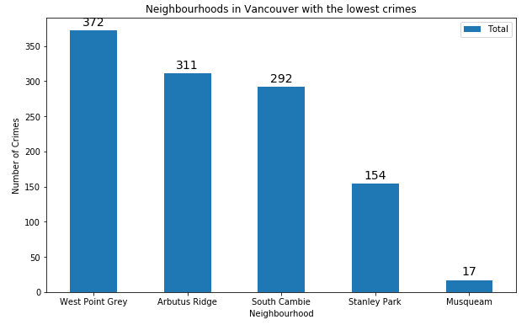
Methodology - Exploratory Data Analysis
Neighborhoods in Vancouver with Lowest Crimes

Slide 7
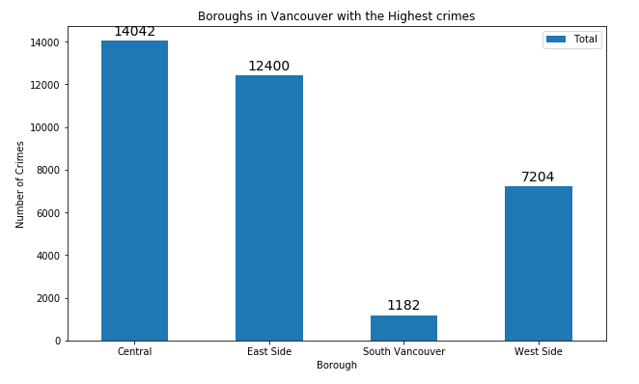
Methodology - Exploratory Data Analysis
Boroughs in Vancouver with Highest Crimes

Slide 8
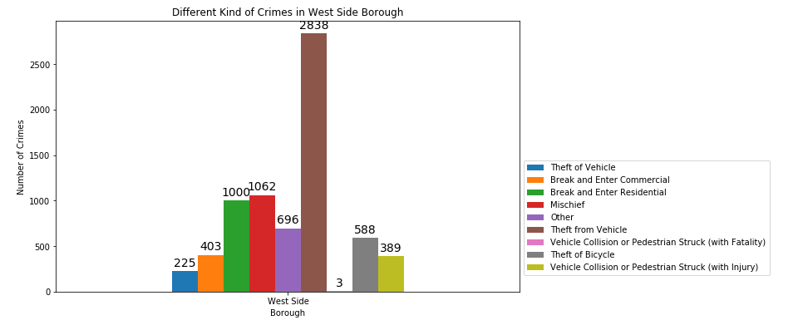
Methodology - Data Visualization
Kinds of Crimes in West Side Borough in Vancouver

Slide 9
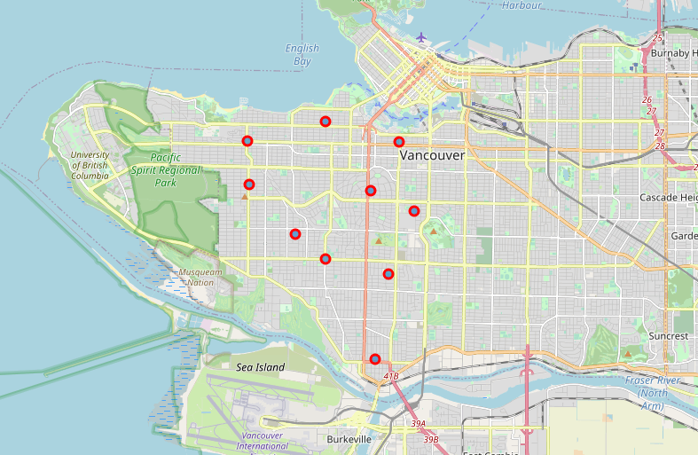
Methodology – Neighborhoods in West Side Borough
Clustering the Neighborhoods venues using Four Square API and plotted in Map using Folium

Slide 10
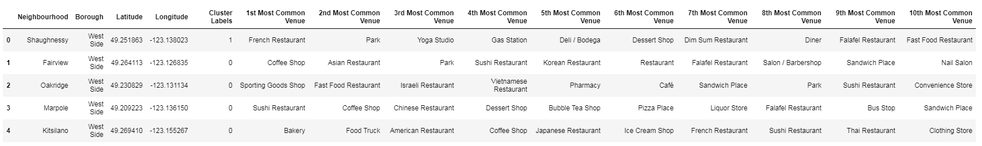
Modelling
Choose the right neighborhood within a Borough with clustering similar neighborhoods using K - means clustering.
Clusters data based on predefined cluster size.
Add Latitude and Longitude for each neighborhood.

Slide 11
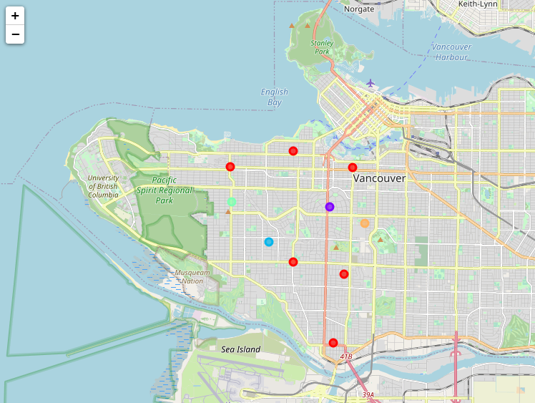
Modelling
Clustering the Neighborhoods and plotted in Map using Folium

Slide 12
Analysis
Cluster Analysis #2
vancouver_merged.loc[vancouver_merged['Cluster Labels'] == 1, vancouver_merged.columns[[1] + list(range(5, vancouver_merged.shape[1]))]]
Cluster Analysis #3
vancouver_merged.loc[vancouver_merged['Cluster Labels'] == 2, vancouver_merged.columns[[1] + list(range(5, vancouver_merged.shape[1]))]]
Cluster Analysis #4
vancouver_merged.loc[vancouver_merged['Cluster Labels'] == 3, vancouver_merged.columns[[1] + list(range(5, vancouver_merged.shape[1]))]]
Cluster Analysis #5
vancouver_merged.loc[vancouver_merged['Cluster Labels'] == 4, vancouver_merged.columns[[1] + list(range(5, vancouver_merged.shape[1]))]]

Slide 13
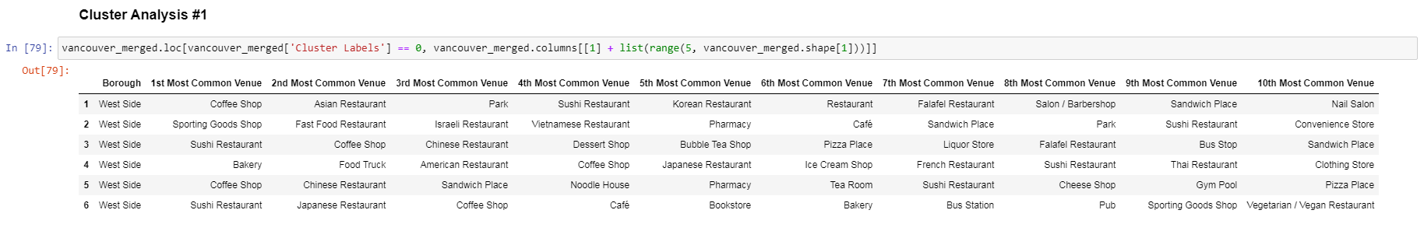
Results
The objective of the business problem helps the stakeholders identify one of the safest borough in Vancouver, an appropriate neighborhood within the borough to set up a commercial establishment a Grocery store.
Cluster Analysis #1
vancouver_merged.loc[vancouver_merged['Cluster Labels'] == 0, vancouver_merged.columns[[1] + list(range(5, vancouver_merged.shape[1]))]]

Slide 14
Discussion
Achieved by making use of Vancouver crime data to identify a safe Borough with considerable number of neighborhood.
After selecting the Borough, the result chooses the right neighborhood where grocery shops were not among venues in a close proximity to each other.
The result achieved by grouping the neighborhoods into clusters to assist the stakeholders by providing them with relevant data about venues and safety of a given neighborhood.

Slide 15
Conclusion
Thus, we have explored the crime data to understand the different types of crimes in all neighborhoods of Vancouver.
The data has categorized them into different Borough, which helps to group the neighborhoods into boroughs and choose the safest borough first.
When the confirmed Borough number of neighborhoods is down, we can further shortlist the neighborhoods based on the common venues, to choose a neighborhood which best suits the business problem.

